Slide 1

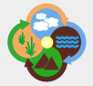
Using observational data models to enhance data interoperability for integrative biodiversity and ecological research
Mark Schildhauer*, Luis Bermudez, Shawn Bowers,
Phillip C. Dibner, Corinna Gries, Matthew B. Jones,
Deborah L. McGuinness, Steve Kelling, Huiping Cao, Ben Leinfelder, Margaret O’Brien, Carl Lagoze, Hilmar Lapp, and Joshua Madin
Rauischholzhausen, Germany: meeting on “Data repositories in environmental sciences: concepts, definitions, technical solutions and user requirements” Feb. 2011
* presenter; see end of presentation for affiliations
SONet

Slide 2
Integrative Environmental Research
Analyses require a wide range of data
  Broad scales: geospatial, temporal, and biological
  Diverse topics: abiotic and biotic phenomena
    Predicting impact of invasive insect species on crop production
    Documenting effects of climate change on forest composition
Large amounts of relevant data…
  E.g., over 25,000 data sets are available in the
  Knowledge Network for Biocomplexity repository
  (KNB– http://knb.ecoinormatic.org)
But researchers struggle to …
  Discover relevant datasets for a study
  And combine these into an integrated product to analyze

Slide 3
How to discover and interpret data needed for
integrative, synthetic environmental science?
  metadata and keywords are good start, but not enough: ambiguous, idiosyncratic, hard to parse
  controlled vocabularies: an improvement, but can do more with today’s technology
  Ontologies: based on Web standards (W3C)—RDF, SKOS, OWL—
    Provide inferencing capabilities
    Establish relationships among terms (subclass relationships, object properties, domain/range constraints)

Slide 4
Observational data
Environmental and earth science data often consists of “observations”
Data sets are often stored in tables (e.g., flat files, spreadsheets)
Represent collections of associated measurements
Highly heterogeneous (format, content, semantics)
(cell) Values represents measurements

Slide 5
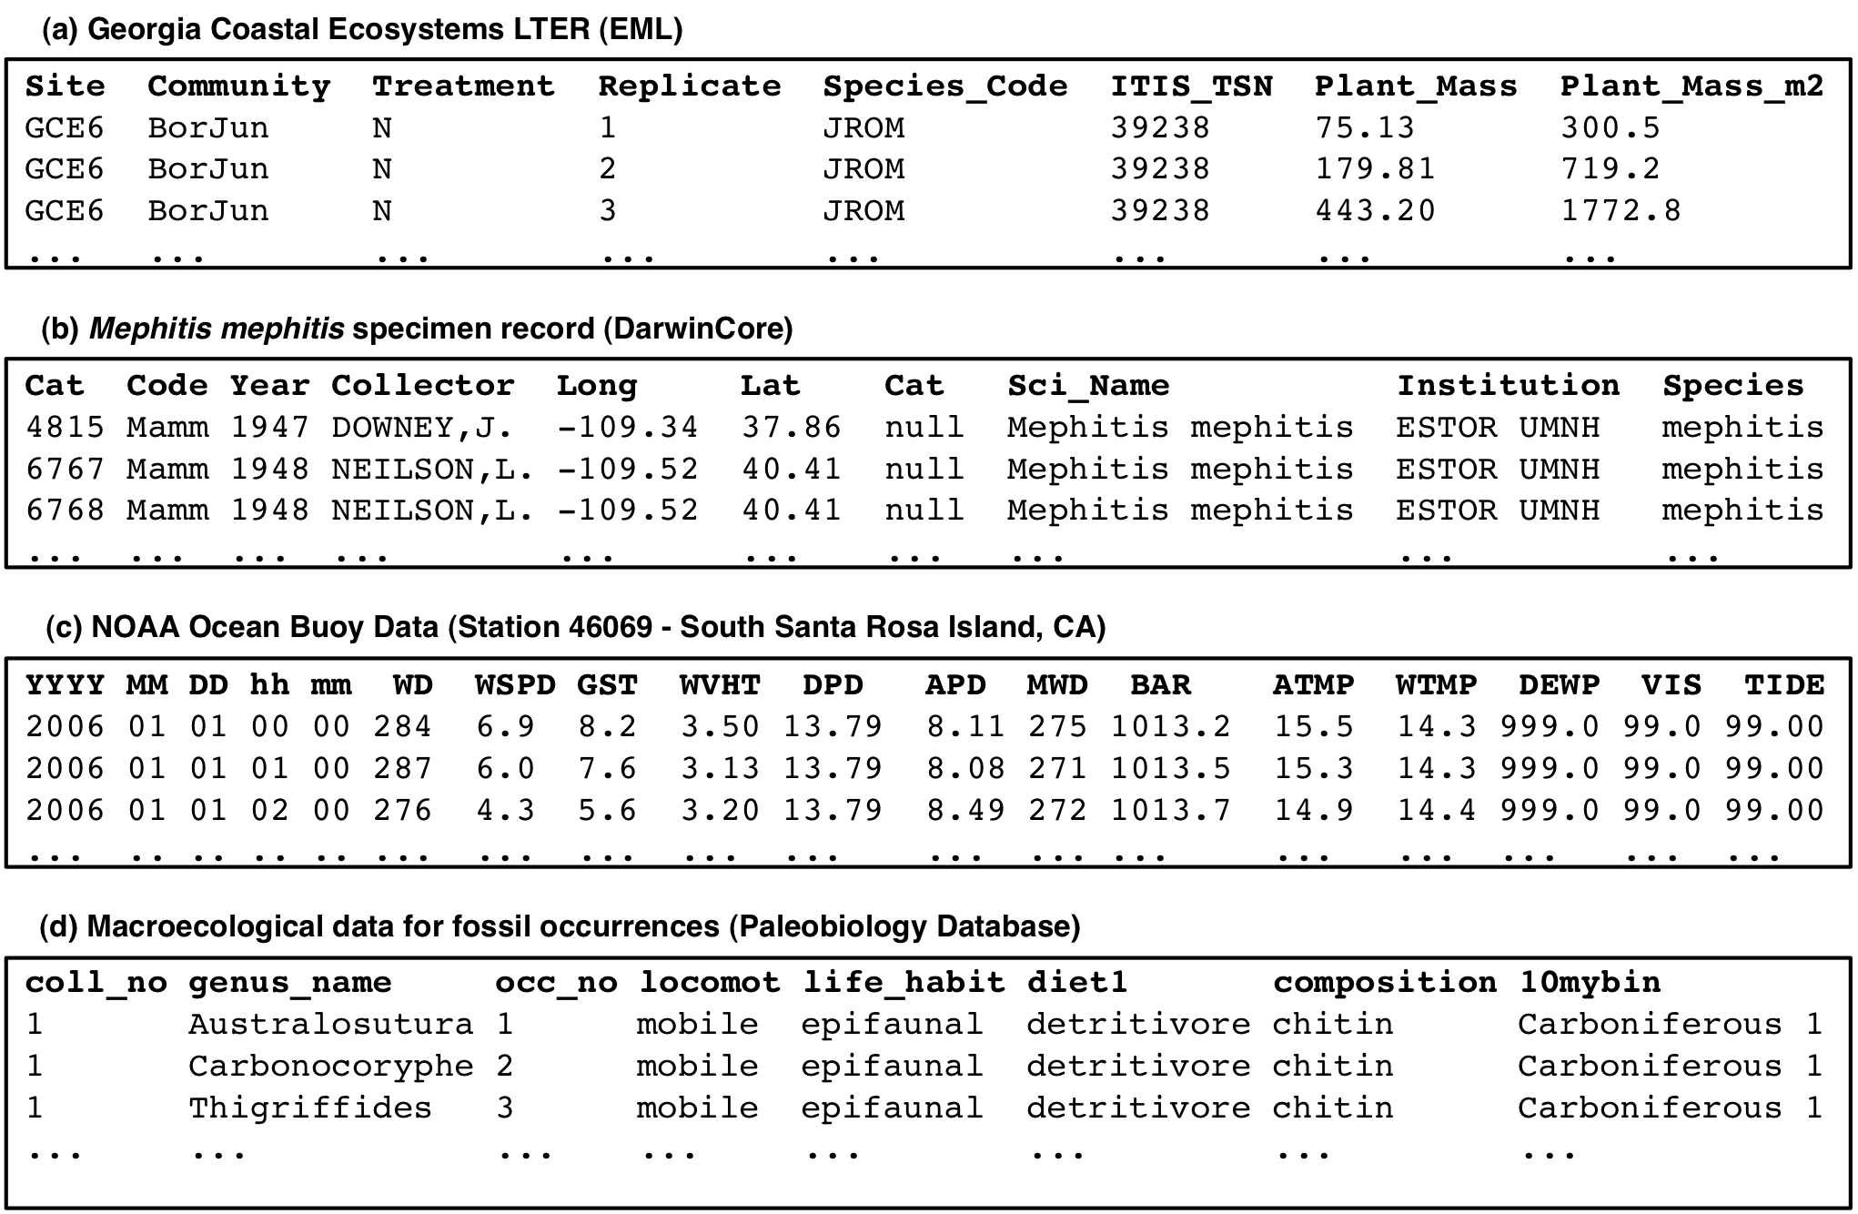
Examples of “raw” observational data

Slide 6
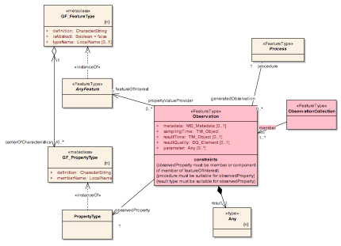
Observational Data Models
Emerging conceptual models for observations
Many earth science communities
Motivated by need for intra and inter-disciplinary data discovery and integration
Provide high level representations of observations
  Based on a standard set of “core concepts”
  Entities, their measured properties, units, protocols, etc.
  Specific terms and how these are modeled vary

Slide 7
Several prospective observation models…
Project | Domain | Observational data model
VSTO | Atmospheric sciences | Ontologies for interoperability among different meteorological metadata standards and other atmospheric measurements
SERONTO | Socioecological research | Ontology for integrating socio-ecological data
OGC’s O&M | Geospatial | Observations and Measurements standard for enhancing sensor data interoperability
SEEK’s OBOE | Ecology | Extensible Observation Ontology for describing data as observations and measurements
PATO’s EQ | Phenotype/Evolution | Underlying model for describing phenotypic traits to link with genomic data

Slide 8
Observational Data Models
High degree of similarity across models
Potentially enable
better data interoperability and uniform access
  Domain-neutral “foundational” template
  Abstracts away underlying format issues
  Domain ontologies help formalize semantics of terms used to describe measurements

Slide 9
Observational Data Model
Implemented as an OWL-DL ontology
  Provides basic concepts for describing observations
  Specific “extension points” for domain-specific terms
Context
*
ObservedEntity
*
Observation
Entity
*
1..1
1..1
1..1
*
Value
Measurement
*
+ precision : decimal
+ method : anyType
*
1..1
Characteristic
0..1
*
*
0..1
Protocol
Standard

Slide 10
Observational Data Model
Observations are of entities (e.g., Tree, Plot, …)
  An observation can have multiple measurements
  Each measurement is taken of the observed entity
Context
*
ObservedEntity
*
Observation
Entity
*
1..1
1..1
1..1
*
Value
Measurement
*
+ precision : decimal
+ method : anyType
*
1..1
Characteristic
0..1
*
*
0..1
Protocol
Standard

Slide 11
Observational Data Model
A measurement consists of
  The characteristic measured (e.g., Height)
  The standard used (e.g., unit, coding scheme)
  The measurement protocol
  The measurement value
Context
*
ObservedEntity
*
Observation
Entity
*
1..1
1..1
1..1
*
Value
Measurement
*
+ precision : decimal
+ method : anyType
*
1..1
Characteristic
0..1
*
*
0..1
Protocol
Standard

Slide 12
Observational Data Model
Observations can have context
  E.g. geographic, temporal, or biotic/abiotic environment in which some measurement was taken
  Context is an observation too
  Context is transitive
Context
*
ObservedEntity
*
Observation
Entity
*
1..1
1..1
1..1
*
Value
Measurement
*
+ precision : decimal
+ method : anyType
*
1..1
Characteristic
0..1
*
*
0..1
Protocol
Standard

Slide 13
Similarities among Observational Data Models
OGC’s Observations and Measurements (O&M)
ObservationContext
relatedContextObservation
FeatureOfInterest
ofFeature
OM_Observation
carrierOfCharacteristic
forProperty
ObservedProperty
usesProcedure
hasResult
OM_Process
Result

Slide 14
Similarities among Observational Data Models
SEEK/Semtools Extensible Observation Ontology (OBOE)
Context (other Observation)
hasContext
Observation
Entity
ofEntity
hasMeasurement
hasCharacteristic
hasValue
Measurement
ofCharacteristic
Characteristic
usesProtocol
hasPrecision
usesStandard
Protocol
Standard
Precision
(a) Dataset
(b) Semantic annotation to dataset (a)

Slide 15
Seronto basic classes:
Similarities among Observational Data Models

Slide 16
Developing a core model (SONet project)
Identify the key observational models in the earth and environmental sciences
Are these various observational models easily reconciled and/or harmonized?
Are there special capabilities and features enabled by some observational approaches?
What services should be developed around these observational models?
Notes:
16

Slide 17
Similarities among Observational Data Models
OBOE
O&M
Entity
FeatureOfInterest
Characteristic
ObservedProperty
Measurement
OM_Observation
Protocol
OM_Process
Standard
Value
Precision
Result
Context
ObservationContext
(b) Semantic annotation to dataset (a)

Slide 18
How to use observational data models…

Slide 19
Linking data values to concepts through observations
Observational data models provide a high-level, domain-neutral abstraction of scientific observations and measurements
Can link data (or metadata) through observational data model to terms from domain-specific ontologies
Context can inter-relate values in a tuple
Can provide clarification of semantics of data set as a whole, not just “independent” values

Slide 20
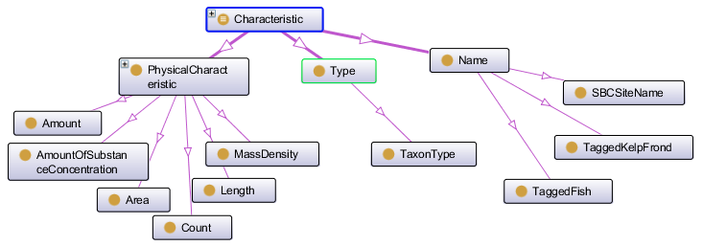
ObsDB – Observational Data Model
Terms drawn from domain-specific ontologies
  E.g., for Entities, Characteristics, Standards, Protocols

Slide 21
SONet/Semtools Semantic Approach
Data-> metadata-> annotations-> ontologies
Annotations link EML metadata elements to concepts in ontology thru Observation Ontology
EML metadata describe data and its structures

Slide 22
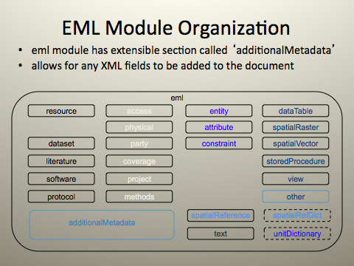

Slide 23
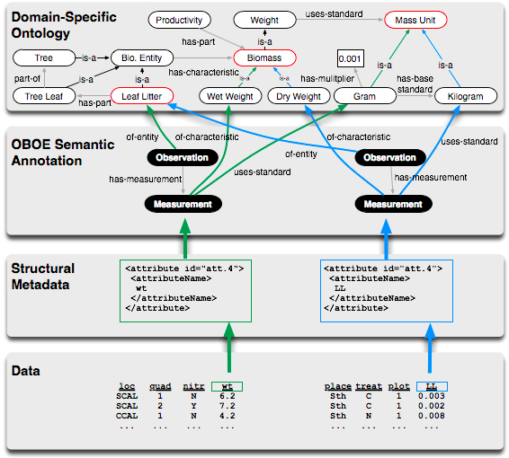
Semantic annotation
Attribute
mappings

Slide 24

Morpho
    documents ecological data through formal metadata
    based on Ecological Metadata Language (EML)-- XML-schema
    local and network storage and querying
    supports attribute-level descriptions of tabular data
    originally developed under NSF-funded KNB project
    Free, multi-platform, java-based EML-editing and KNB querying tool
    Prospective querying client for DataONE repository

Slide 25
Semtools
∀
Extends Morpho codebase
    builds on existing rich metadata corpus (KNB)
    semantic annotation of data through metadata
    map attribute-level metadata descriptions to observation model
    uses core model defined by SONet
    access domain ontologies through OBOE
    semantic querying

Slide 26
Load Domain Ontology
Can load custom OBOE-compatible ontology
Ontology development work underway:
    Santa Barbara Coastal LTER ontology
    Plant Trait Ontology (TraitNet, CEFE/CNRS, TRY, etc.)
    Others

Slide 27
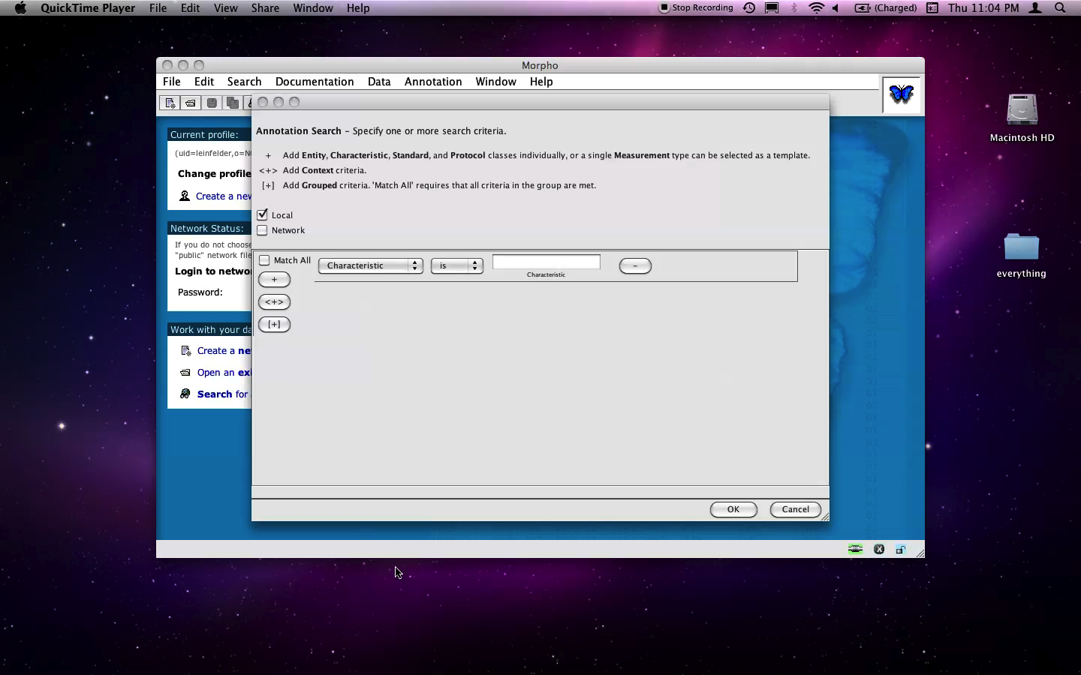
Load and Use Multiple Ontologies

Slide 28
Semantic Annotation
Apply semantic annotation to data attribute of
  “veg_plant_height”
    Characteristic (Height)
    Entity (Plant)
    Standard (Meters)
    terms from Observation Ontology (OBOE.OWL)
    terms from Domain Ontology (Plant-trait.OWL)

Slide 29
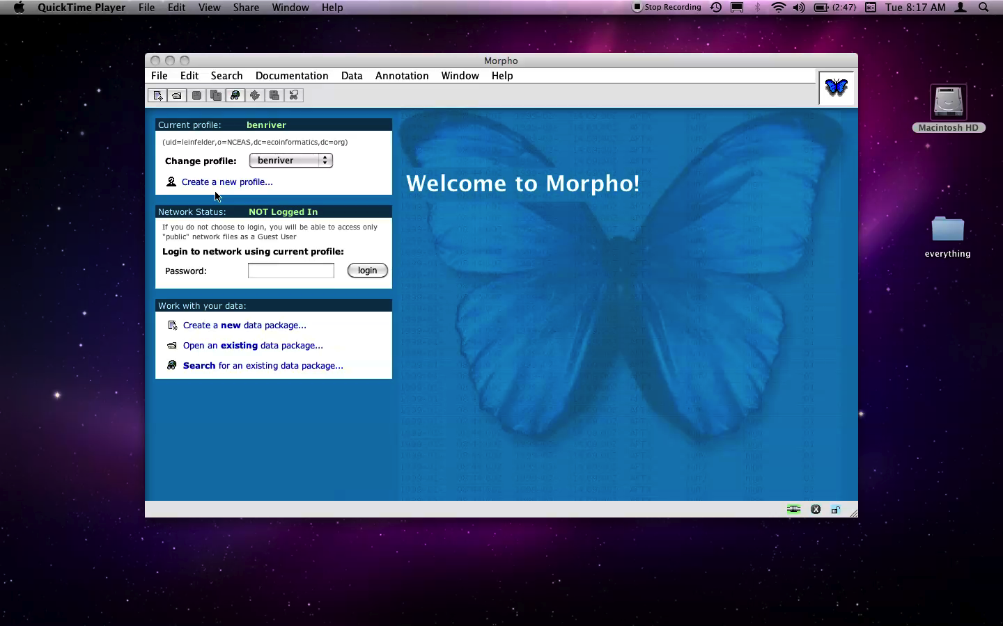
Open Data Annotation Frame

Slide 30
Semantic annotation
Observation “schema” for Dataset
Observation “o2”
Entity “exp:ExperimentalReplicate”
Measurement “m2”
Entity “oboe:Name”
...
Observation “o3”
Entity “oboe:Tree”
Measurement “m3”
Characteristic: “oboe:TaxonType”
...
Measurement “m4”
Characteristic “units:Height”
Standard “units:Meter”
...
Context “o2”
...
Formal syntax for annotation
Can provide “key-like” capabilities
Attribute
mappings
site | plot | spp | ht | dbh | pH
GCE1 | A | piru | 21.6 | 36.0 | 4.5
GCE1 | B | piru | 27.0 | 45 | 4.8
… | … | … | … | … | …
GCE9 | A | abba | 23.4 | 39.1 | 3.9

Slide 31
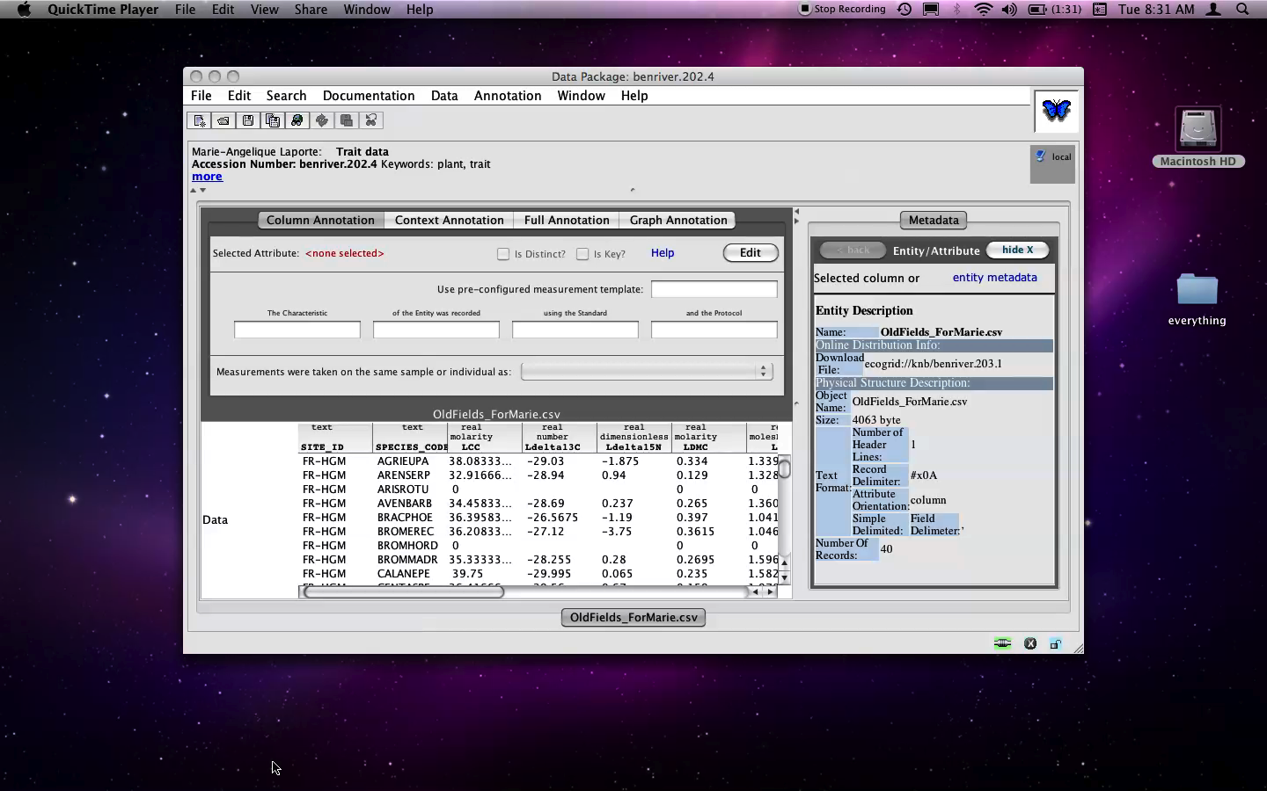
Semantic Annotation in Morpho

Slide 32
Semantic Search
Enable structured search against annotations to increase precision
Enable ontological term expansion to increase recall
Precisely define a measured characteristic, the standard used to measure it, and its relation to other observations, via an observational data model

Slide 33
Query Precision
Keyword-based search
    “kelp”
    3 data sets found
Observational semantics-based search
    Entity=”kelp”
    1 data set found

Slide 34
Query Expansion
Entity=Kelp AND Characteristic=DryMass
    1 record
    Macrocystis is subclass of Kelp
Entity=Kelp AND Characteristic=Mass
    2 Records
    DryMass is subclass of Mass

Slide 35
Query by Observation
Measurements are from same sample instance
  Entity=Kelp
  AND
  Characteristic=DryMass
  AND
  Characteristic=WetMass

Slide 36

Query by Observation

Slide 37
Future Directions
    Continue building corpus of semantically-annotated data
    Refine “design patterns” for observation-compliant domain ontologies
    Align/integrate ontologies at common points
        Mass, units
    Iterate design for annotation interface
    Stronger inferencing: measurement types, transitivity along properties (e.g., partonomy), data “value-based” querying
    Semi-automated aggregation, integration

Slide 38
ObsDB – Query Support
Querying observations
Simple examples …
  Tree
  Selects all observations of Tree entities
  Tree[Height] in d1
  Selects d1 observations of trees with height measurements
  Tree[Height, DBH Meter]
  Same as above, but with diameter in meters

Slide 39
ObsDB – Query Support
More examples …
  Tree[Height > 20 Meter]
  Selects observations of trees with height > 20 m
  Supports standard SQL comparators …
  Tree[Height between 12 and 25 Meter]
  Same as above, but 12 ≤ height ≤ 25
  (Tree[Height Meter], Soil[Acidity pH])
  Selects all observations of trees (with height measures) and soils (with acidity measures)

Slide 40
ObsDB – Query Support
Context examples …
  Tree[Height] -> Soil[Acidity]
  Selects tree and soil observations where soil contextualizes the tree measurement
  Tree -> Plot -> Site
  Context chains (Tree, Plot, and Site observations returned)
  (Tree, Soil) -> Plot -> Site
  Tree and Soil observations contextualized by the same Plot observation
  (Tree, Soil) -> (Plot, Zone)
  Tree, soil contextualized by (same) plot and zone

Slide 41
Acknowledgements
This material is based upon work supported by the National Science Foundation under Grant Numbers 0743429, 0753144.
Mark Schildhauer*, Matthew B. Jones, Ben Leinfelder: NCEAS, Santa Barbara CA, USA
Luis Bermudez: Open Geospatial Consortium Inc., Wayland MA, USA
Shawn Bowers: Gonzaga University, Spokane WA, USA
Phillip C. Dibner: OGCii, Berkeley CA, USA
Corinna Gries: University of Wisconsin, Madison WI, USA
Deborah L. McGuinness: Rensselaer Polytechnic Institute, Troy NY, USA
Margaret O’Brien: UCSB, Santa Barbara CA, USA
Huiping Cao: New Mexico State University, Las Cruces NM, USA
Simon J.D. Cox: Earth Science & Resource Engrg, CSIRO, Bentley WA, AUS
Steve Kelling, Carl Lagoze: Cornell University, Ithaca NY, USA
Hilmar Lapp: NESCent, Durham NC, USA
Joshua Madin: Macquarie University, Sydney NSW, AUS
* presenter
SONet

Slide 42
Further Acknowledgements
Thanks as well:
Marie-Angelique LaPorte CEFE/CNRS- Montpellier
Farshid Ahrestani TraitNet/Columbia
Daniel Bunker TraitNet, NJIT
* presenter
SONet

Slide 43
* presenter
SONet

